Slide 1

Predictive Analytics for Cholera Outbreaks and Historical Data (2000–2023)
Presented by Huruma Innocent
ID:25514
Course: Big Data Institution (AUCA)

Slide 2

Project Introduction: Understanding Cholera
Cholera is an acute diarrheal disease caused by Vibrio cholerae, transmitted via contaminated water/food. It leads to severe dehydration and can be fatal if untreated.

Slide 3
Problem Statement: The Need for Prediction
Cholera remains a global public health threat, causing thousands of deaths annually, especially in low- and middle-income countries. Traditional reactive responses delay intervention, increasing mortality and spread.
Lack of Real-Time Systems
Insufficient Data Integration
No immediate predictive tools for outbreaks.
Environmental and demographic data are not fully utilized.
Delayed Response
Targeting Challenges
Limited surveillance infrastructure hinders quick action.
Difficulty in identifying high-risk populations for prevention.

Slide 4





Project Objectives
Early Warning
Identify outbreak signals from environmental, demographic, and epidemiological data for rapid intervention.
Targeted Prevention
Prioritize high-risk regions for vaccination, clean water, and public awareness.
Resource Optimization
Efficiently allocate limited health resources like medicine and personnel.
Policy Planning
Support long-term planning by predicting seasonal patterns and climate change impact.
Surveillance Enhancement
Improve real-time surveillance and decision-making through system integration.

Slide 5
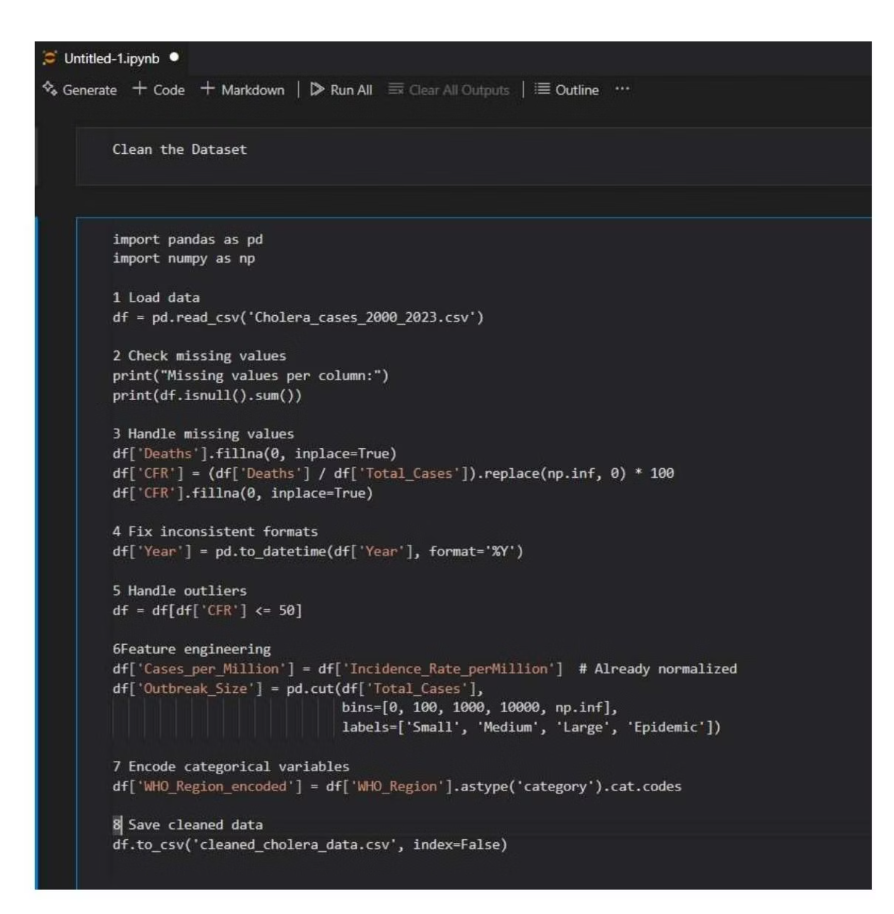
Methodology: Data Collection & Preprocessing
Step 1: Data Collection
Source: WHO Cholera Cases & Deaths (2000-2023)
Format: Structured CSV (1,094 records)
Variables: Cases, Deaths, CFR, Year, Country, Region, Incidence Rate
Step 2: Data Preprocessing
Filled missing values, recalculated CFR, removed outliers (CFR > 50%).
Converted Year to datetime, created Outbreak_Size labels.
Encoded categorical regions (WHO Region).

Slide 6
Step 3: Exploratory Data Analysis (EDA)
Trend analysis: Cases over time (2000–2023)
Region-wise fatality comparison
Top 10 countries with highest outbreak totals
Correlation heatmap: Total Cases vs CFR, Deaths, Incidence
- Step 4: Machine Learning Model
· Model: Random Forest Classifier
· Target: Outbreak severity classification (Outbreak_Size)
· Features: Year, CFR, Incidence Rate, Region (encoded)
· Evaluation: Confusion Matrix, Classification Report

Slide 7
Methodology: Analysis & Modeling
Step 3: Exploratory Data Analysis (EDA)
Step 4: Machine Learning Model
Trend analysis: Cases over time (2000–2023)
Model: Random Forest Classifier
Region-wise fatality comparison
Target: Outbreak severity classification (Outbreak_Size)
Top 10 countries with highest outbreaks
Correlation heatmap: Cases vs CFR, Deaths, Incidence
Features: Year, CFR, Incidence Rate, Region
Evaluation: Confusion Matrix, Classification Report
Innovation: risk_alert() function and Geo mapping

Slide 8
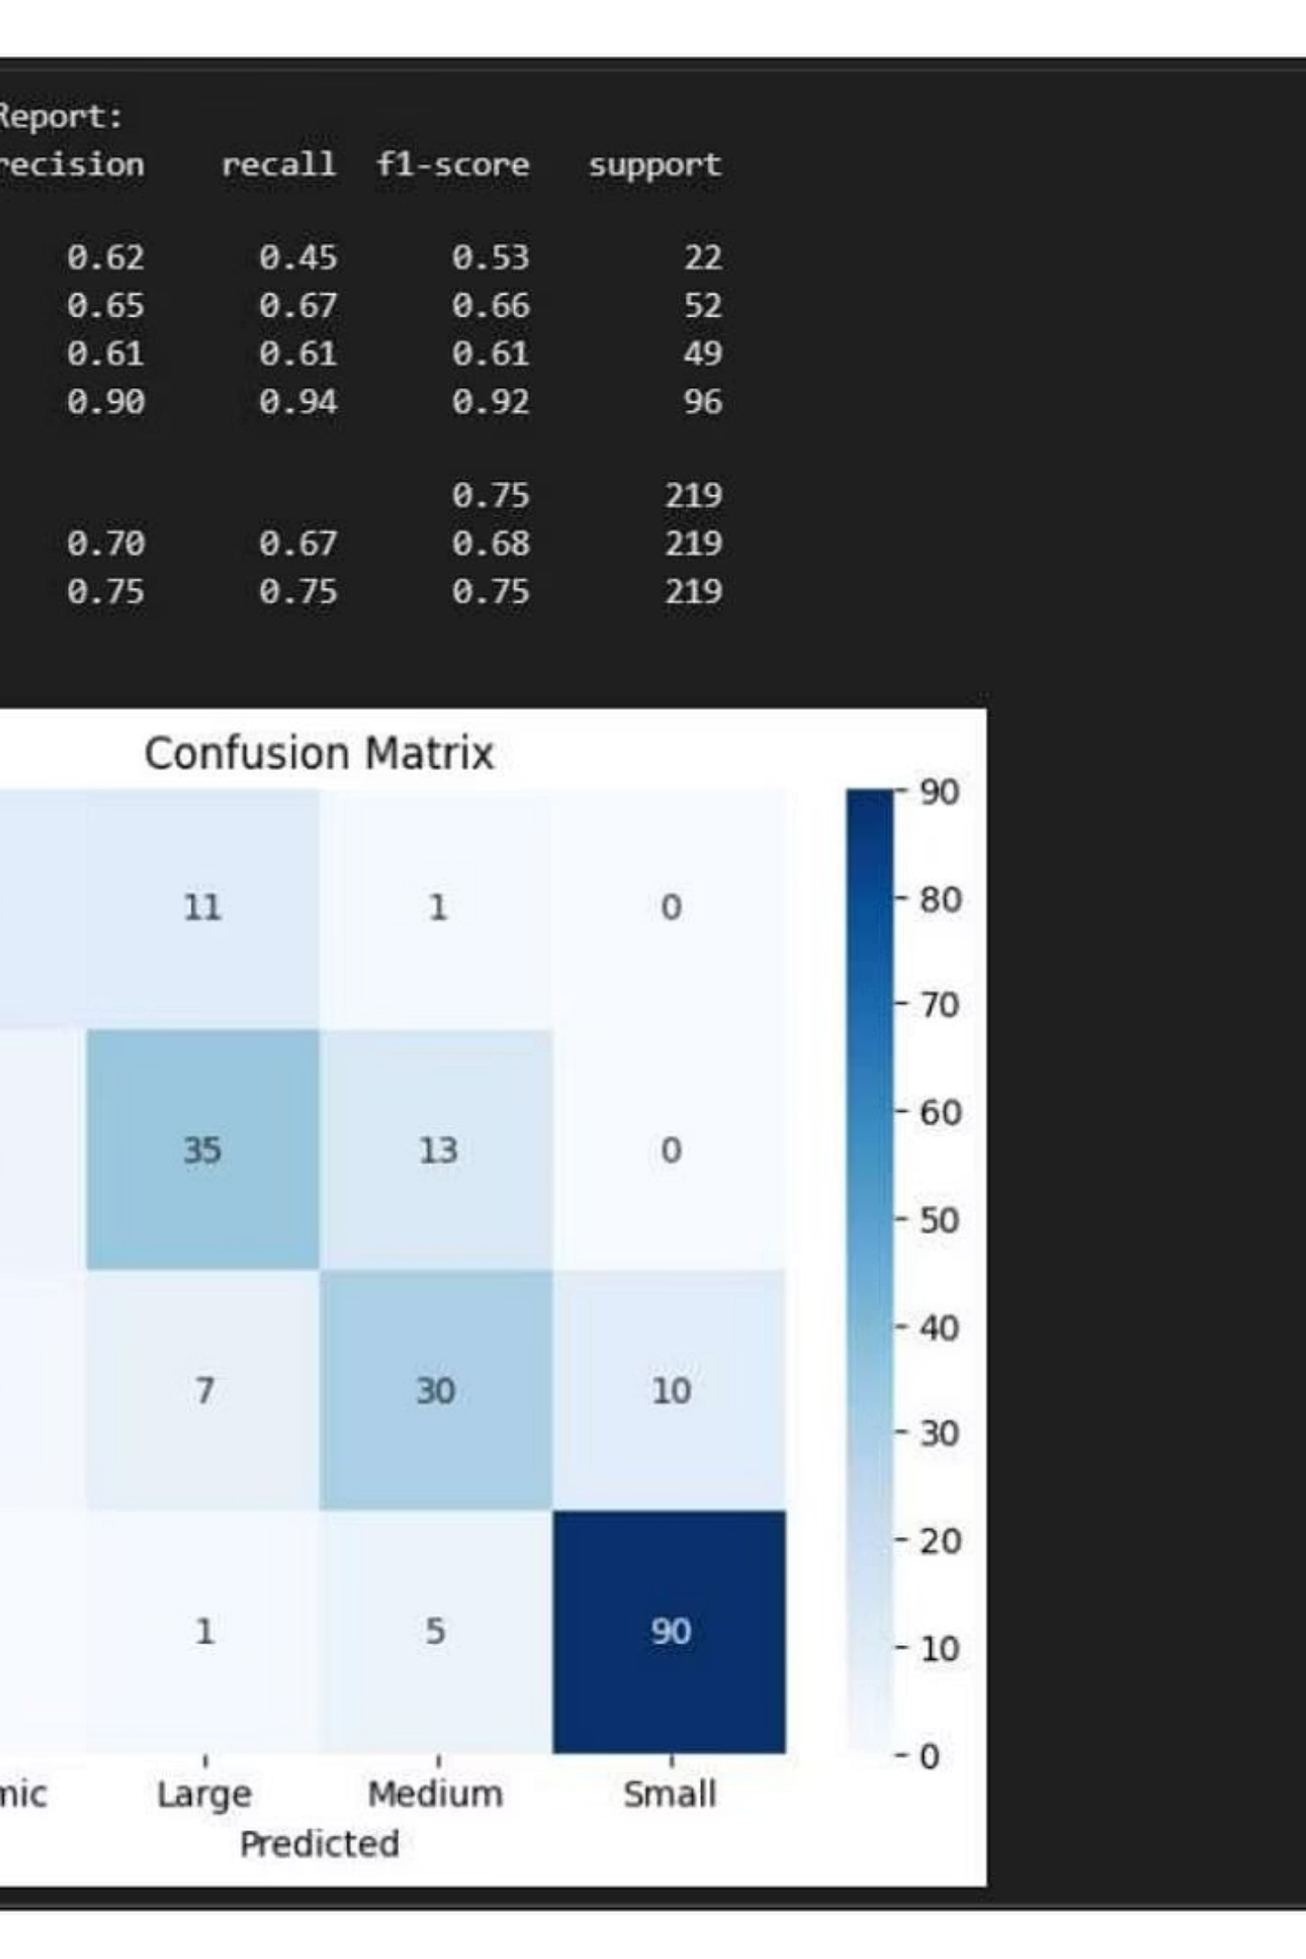
Results: Model Performance & Insights
Model Performance
Insights from EDA
Successfully predicted outbreak severity levels.
Recurrent high-risk countries: DRC, Bangladesh, Yemen.
Achieved high precision and recall in multi-class classification.
Most cholera deaths in GTFCC target countries.
Some countries show high fatality rates despite low cases.
Correctly identified most Epidemic and Large outbreaks.
High-Risk Zone Detection
Custom function highlighted countries like DRC, Somalia, Nigeria, enabling early-warning based on historical trends.

Slide 9
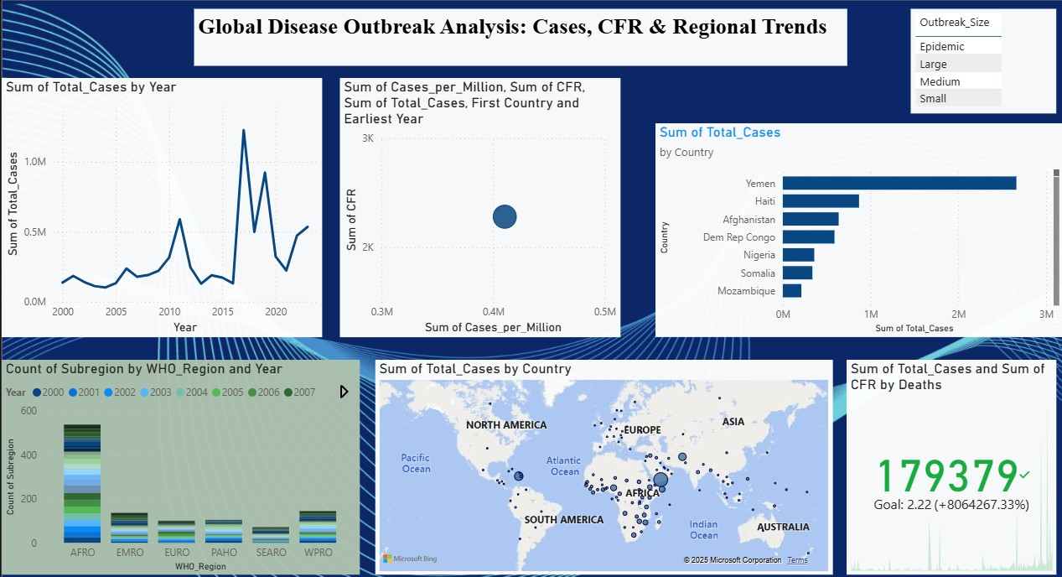
Results: Dashboard Highlights
Dashboard built using Power BI, fully interactive and filterable.
Global case trends by year
Region-wise CFR and outbreaks
Top 10 affected countries
Target vs Non-target country performance
Interactive slicers for Year, Region, Country

Slide 10
Recommendations & Future Work
Recommendations
Future Work
Prioritize GTFCC Countries: Focus vaccination and WASH programs.
Predict Future Outbreaks: Build models using historical data.
Improve Data Integration: Merge health, weather, sanitation, and demographic data.
Identify High-Risk Countries: Analyze patterns in outbreak size, CFR, and geography.
Use ML for Resource Allocation: Direct emergency resources efficiently.
Support Public Health Interventions: Provide insights for early planning.
Encourage Real-Time Monitoring: Adopt predictive dashboards.
Demonstrate Value: Show ML and data visualization effectiveness in public health.

Slide 11

Thank You
Huruma Innocent
ID: 25514
GitHub:https://github.com/Huruma1/Cholera-Capstone-Project.git
Let it serve as a reminder that excellence, integrity, and commitment matter
whether in data science, public health, or everyday life.

